Slide 1
Mentor - Connect
ABISHEK PRANAV S A
KOWSHIKA S
KOWSIKA A
JAYASREE K S

Slide 2
IDEA PROPOSED
To create a platform that provides guidance for the candidates
Creation of automated calendar booking system
Embedded video call and Chat Feature to directly interact with mentors and clarify their queries
User Friendly Interface for easy accessibility of the candidates and mentors
Progress tracking of the mentees and providing task progress bar to ensure motivated growth
Providing Badges for the mentee based on their progress bar
Mentor will be provided with Certificates based on their mentee’s progress to ensure they are engaged with the platform and guide more candidates

Slide 3
UNIQUENESS AND INNOVATION :
Ensures personalized connections
An all-in-one platform integrating scheduling communication, and resources, and scalable architecture that supports a diverse user base
It is continuously improves through real time feedback and is designed to be future proof
Rating to mentors via providing certificates based on the count and progress of students they guide.

Slide 4
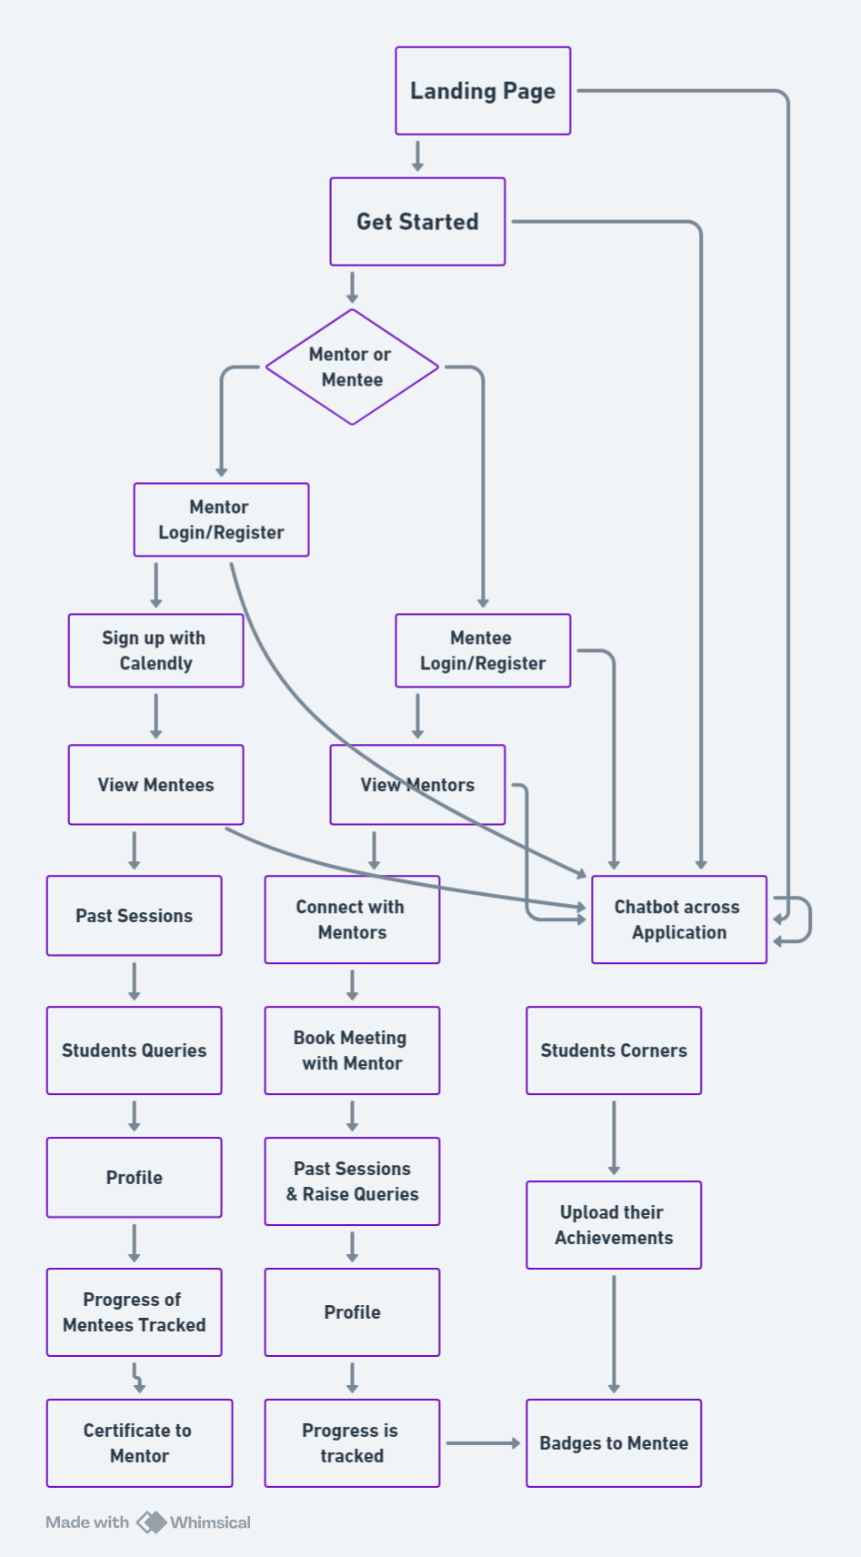
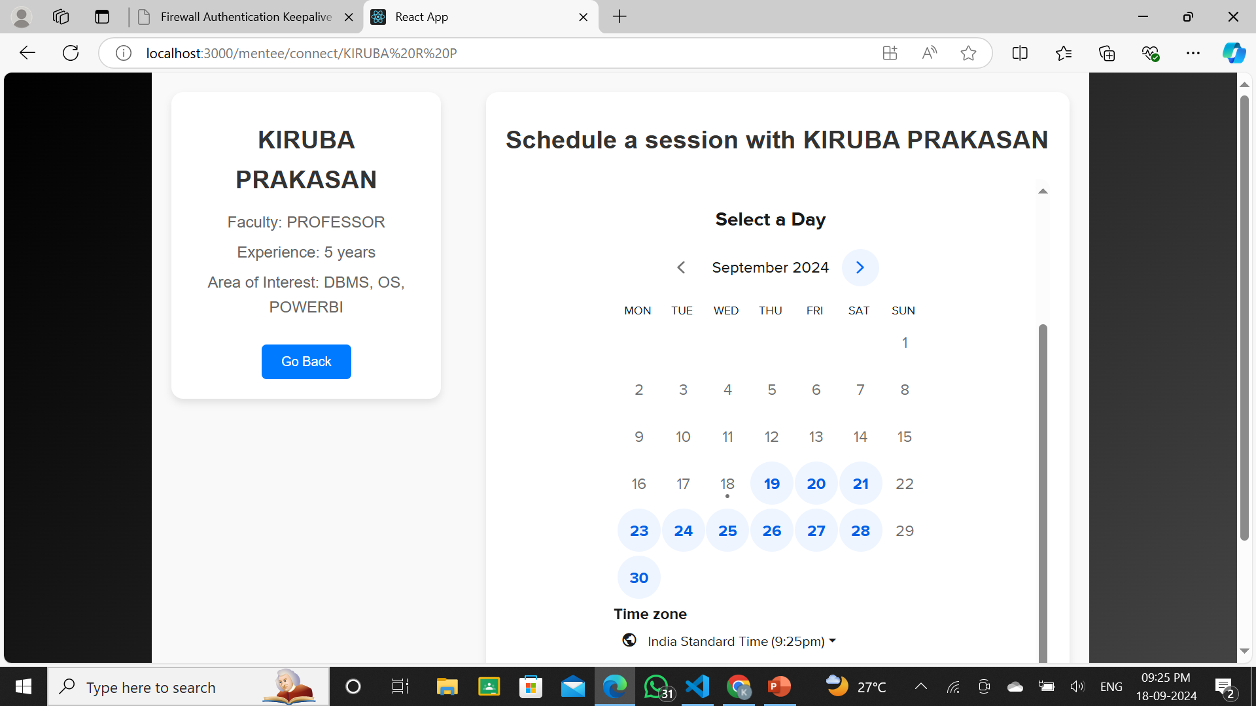
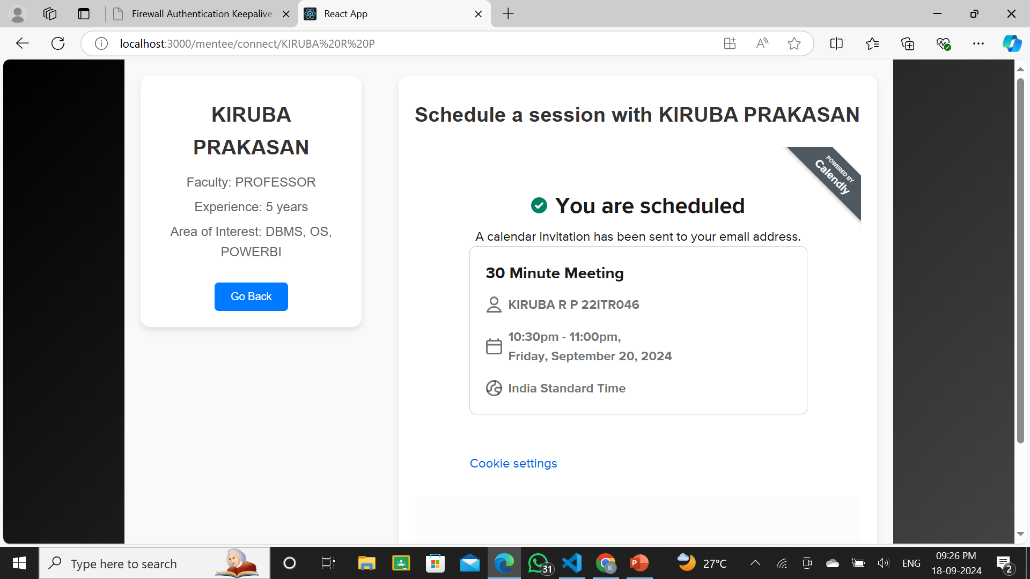
WORK FLOW & APPROACH

Slide 5



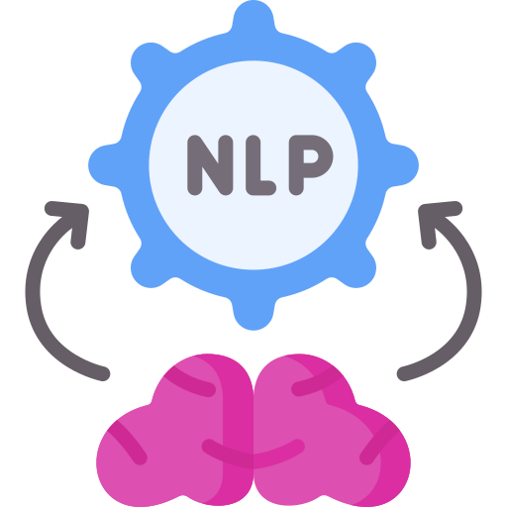
TECHNICAL STACKS
FRONTEND :
HTML , CSS , JS , REACT ( FRAMEWORK )
BACKEND:
MONGODB , FIREBASE
API INTEGRATED :
CALENDLY
AI LOGIC:
NATURAL LANGUAGE PROCESSING FOR CHATBOT

Slide 6
BENEFITS
Social Benefits: Promotes mentorship culture, bridges the skill gap, and fosters a more skilled workforce.
Economic Benefits: Enhances employment opportunities, leading to higher incomes and economic growth.
Educational Benefits: Supports continuous learning and development for both mentors and mentees.
Environmental Benefits: Virtual mentoring reduces the need for physical travel, lowering carbon emissions.
Inclusive Growth: Ensures that mentorship is accessible to candidates from diverse geographic and economic backgrounds.

Slide 7
THANK YOU

